Slide 1
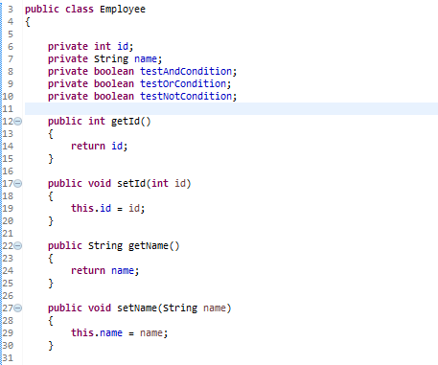
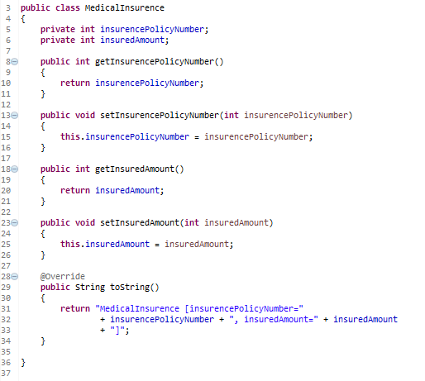

Spring EL Logical operators
…
…

Slide 2
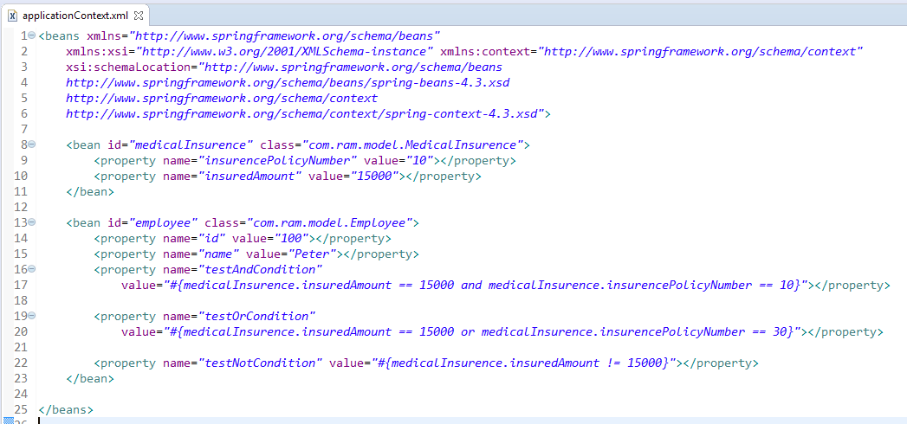
Spring EL supports Logical operators – and, or, and not (!).

Slide 3
